Slide 1


Scientific Machine Learning
Lecture 14: Transformer
孟旭辉
数学与统计学院数学与应用学科交叉创新研究院
办公室：欣苑2栋111室
Email：xuhui_meng@hust.edu.cn
https://github.com/XuhuiM/SciML-Course
5/24/2023

Slide 2
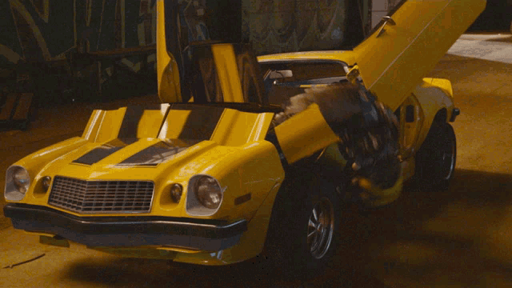
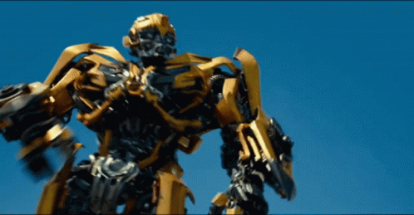
Transformer

Slide 3
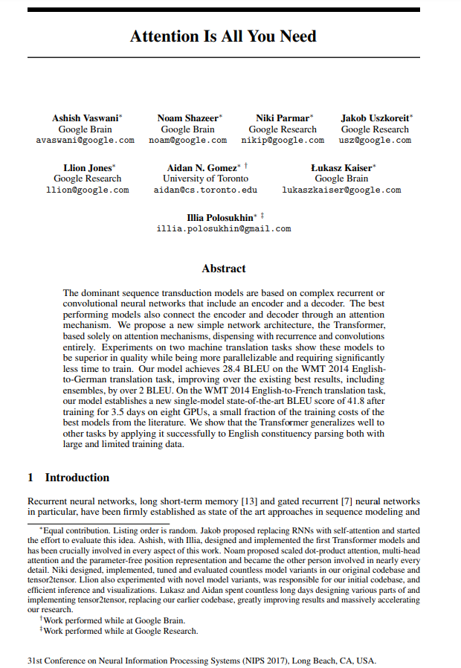

Transformer

Slide 4

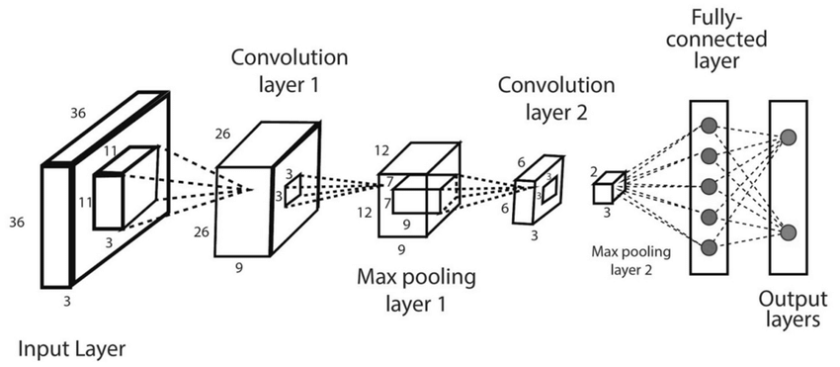
Transformer
Vaswani et al. Neurips, 2017

Slide 5
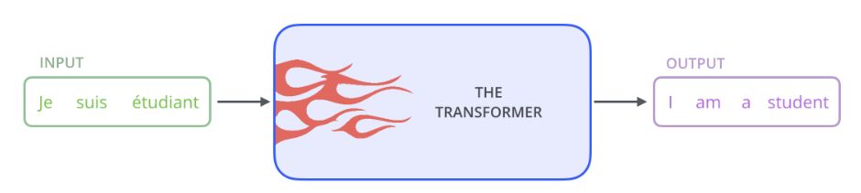
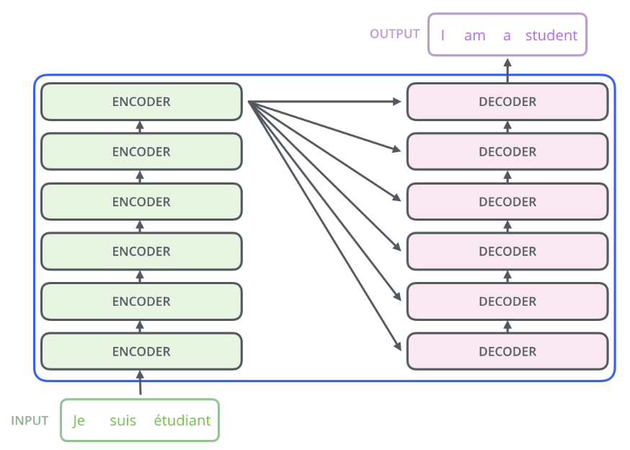
Transformer
Blog of Alammar

Slide 6
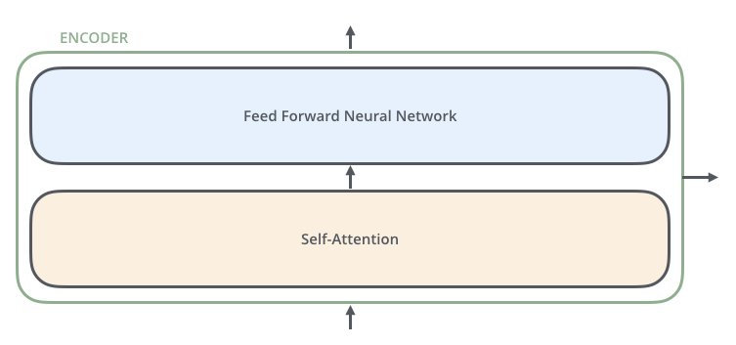
Transformer
Blog of Alammar

Slide 7
Transformer
Blog of Alammar

Slide 8
Transformer: Encoder
Blog of Alammar

Slide 9
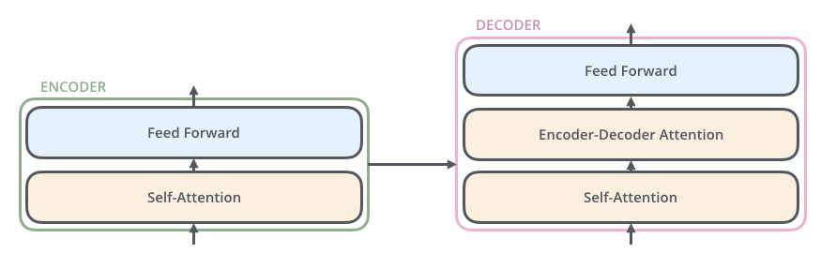
Transformer: Decoder
Blog of Alammar

Slide 10
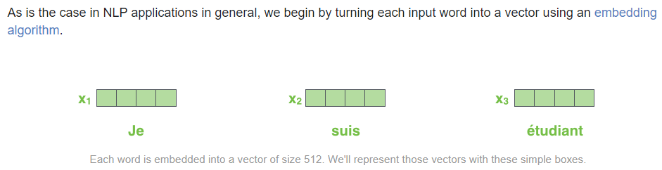
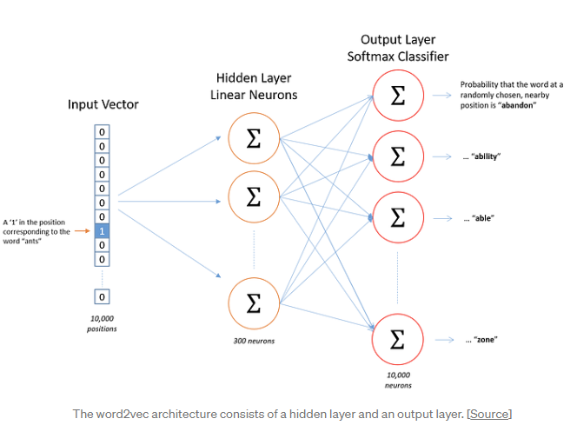
Transformer: Embedding
Blog of Alammar

Slide 11
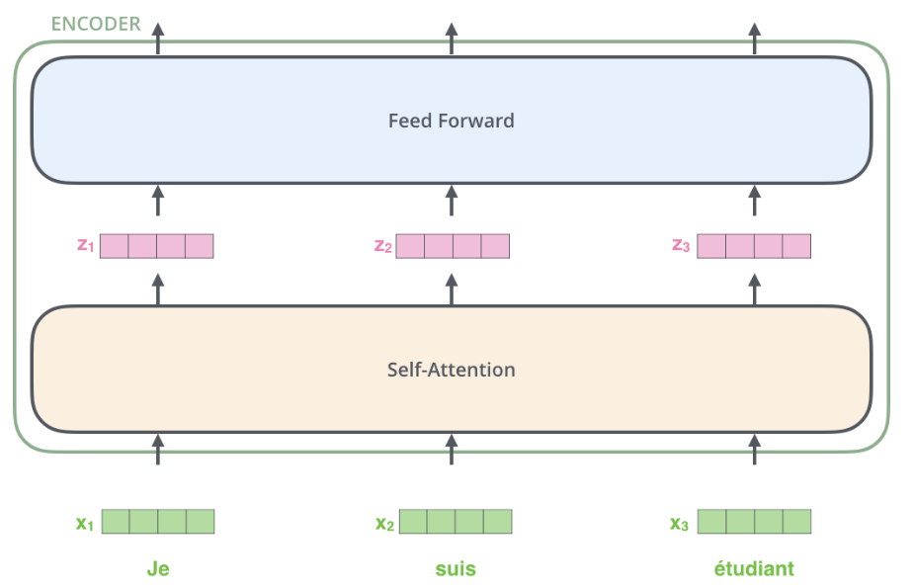
Transformer: Encoder
Blog of Alammar

Slide 12
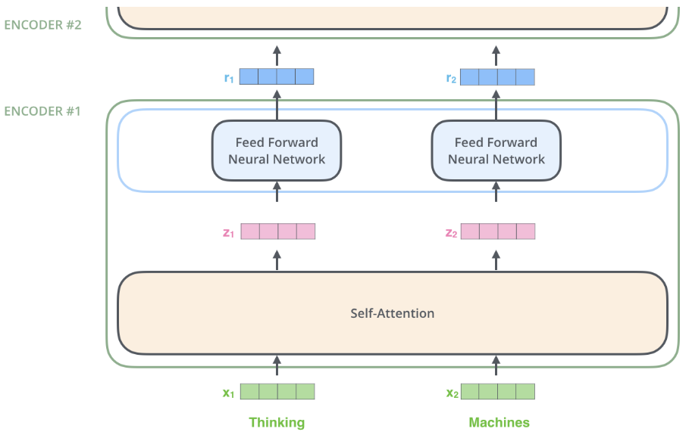
Transformer: Encoder
Blog of Alammar

Slide 13
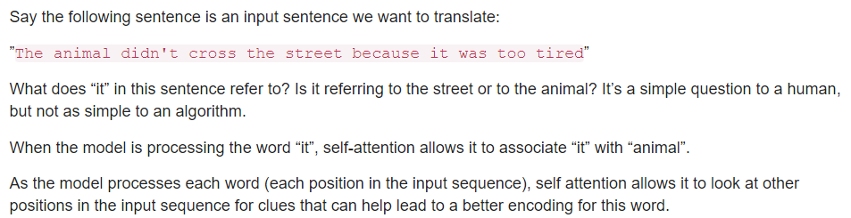
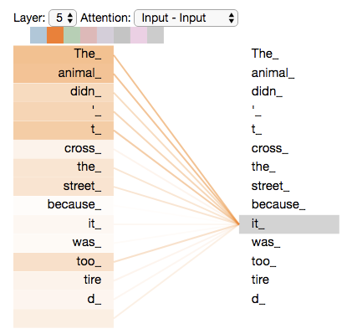
Transformer: Self-attention
Blog of Alammar

Slide 14
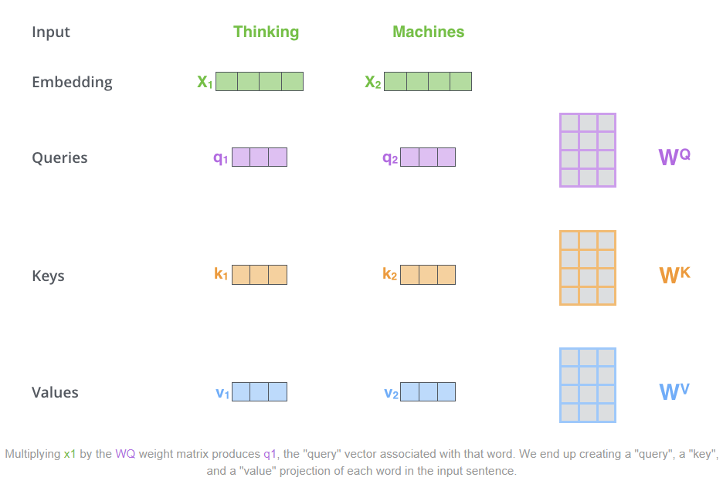
Transformer: Self-attention
Blog of Alammar

Slide 15
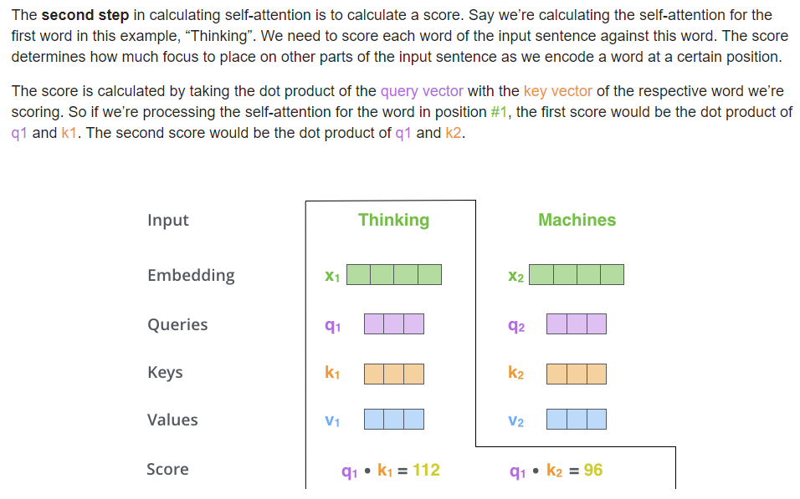
Transformer: Self-attention
Blog of Alammar

Slide 16
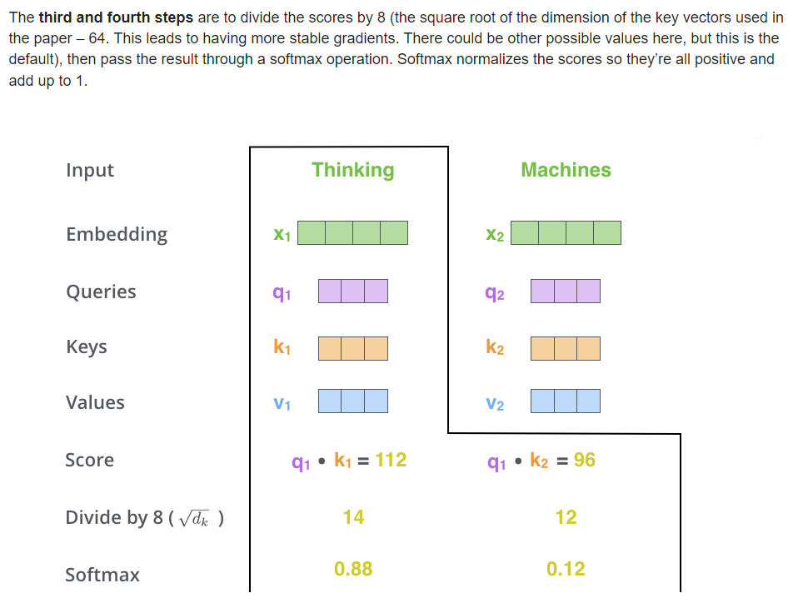
Transformer: Self-attention
Blog of Alammar

Slide 17
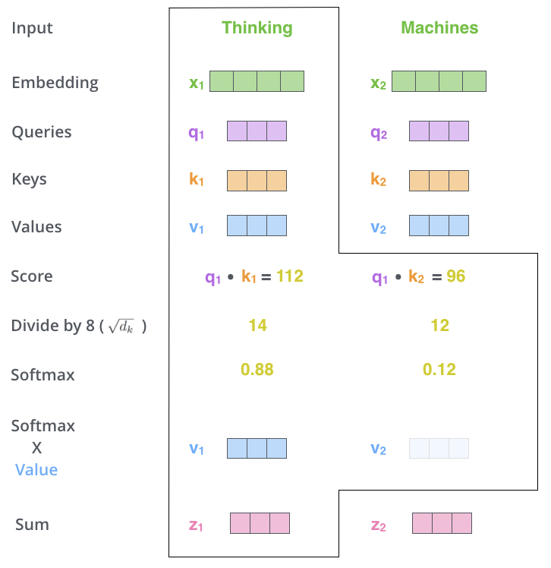
Transformer: Self-attention
Blog of Alammar

Slide 18
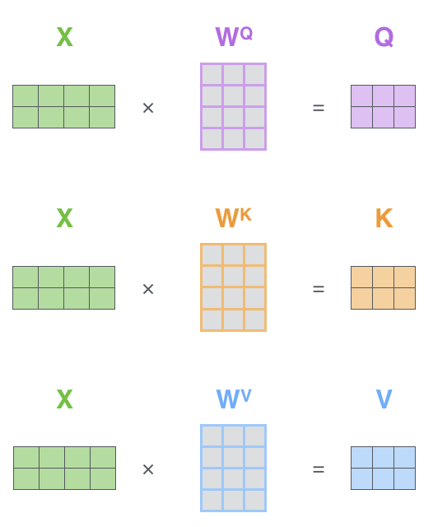
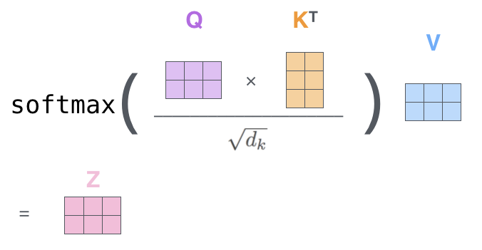
Transformer: Details for self-attention
Blog of Alammar

Slide 19
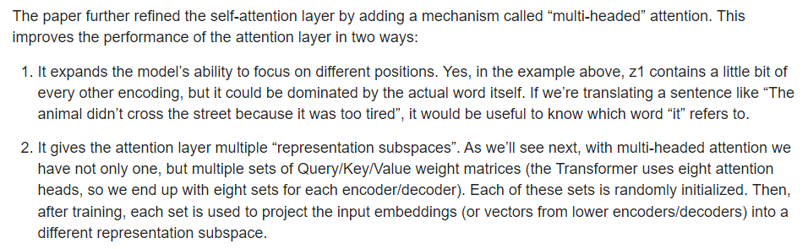
Transformer: Multi-headed attention
Blog of Alammar

Slide 20
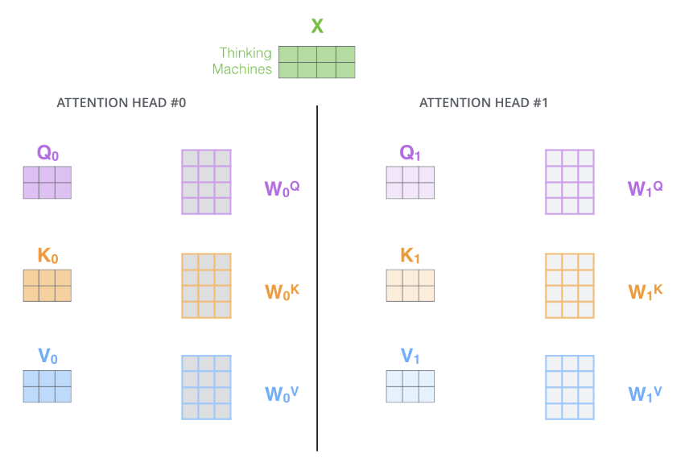
Transformer: Multi-headed attention
Blog of Alammar

Slide 21
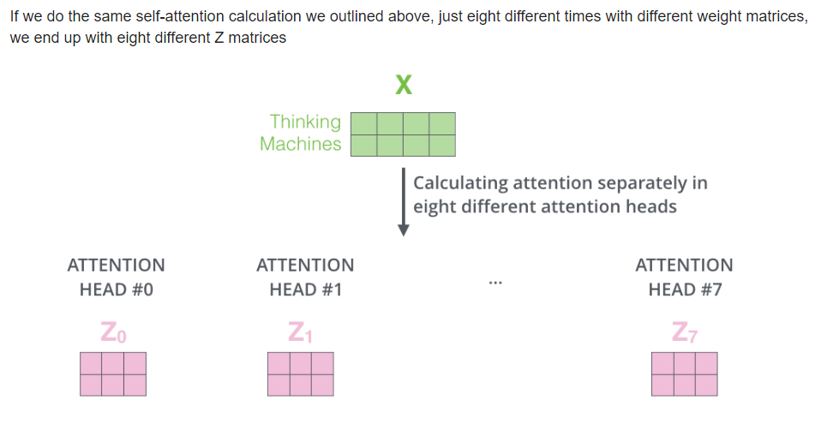
Transformer: Multi-headed attention
Blog of Alammar

Slide 22
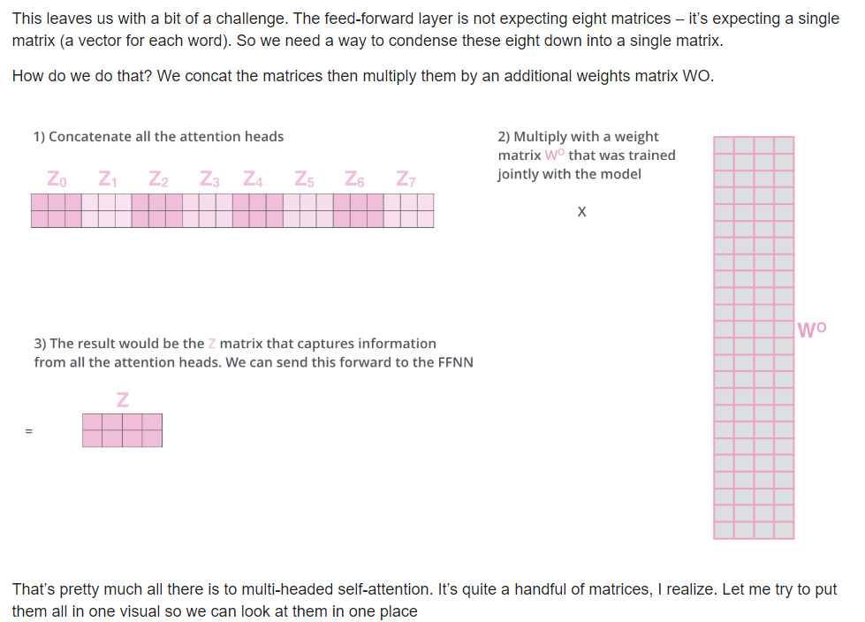
Transformer: Multi-headed attention
Blog of Alammar

Slide 23
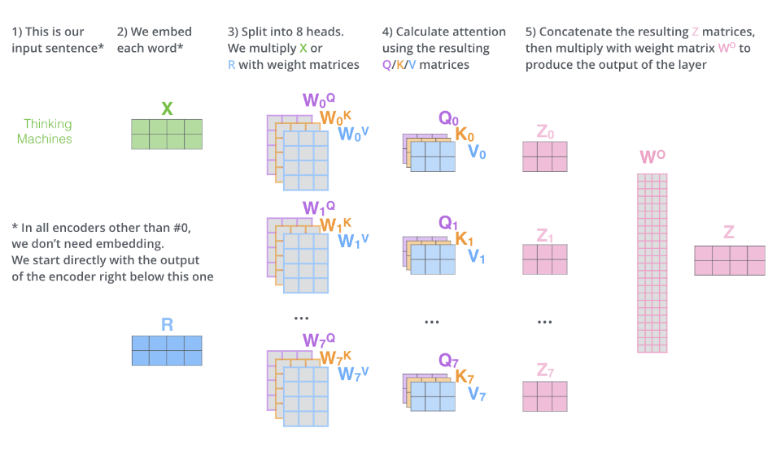
Transformer: Multi-headed attention
Blog of Alammar

Slide 24
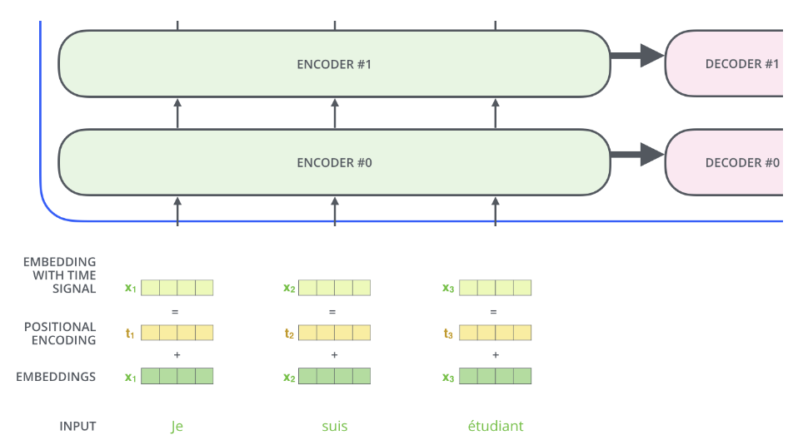
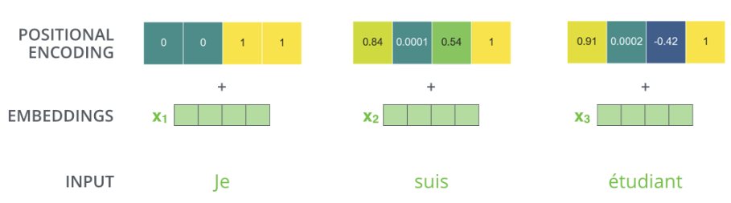
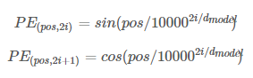
Transformer: Positional Encoding
Blog of Alammar

Slide 25
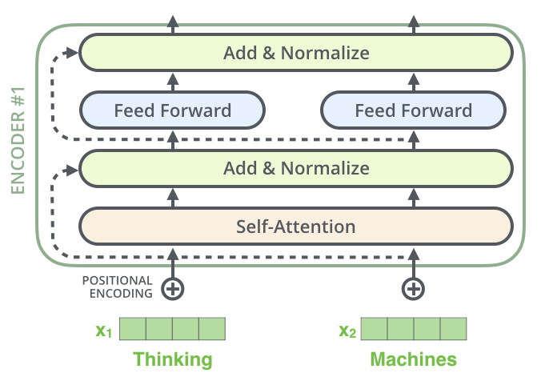
Transformer: ResNets
Blog of Alammar

Slide 26
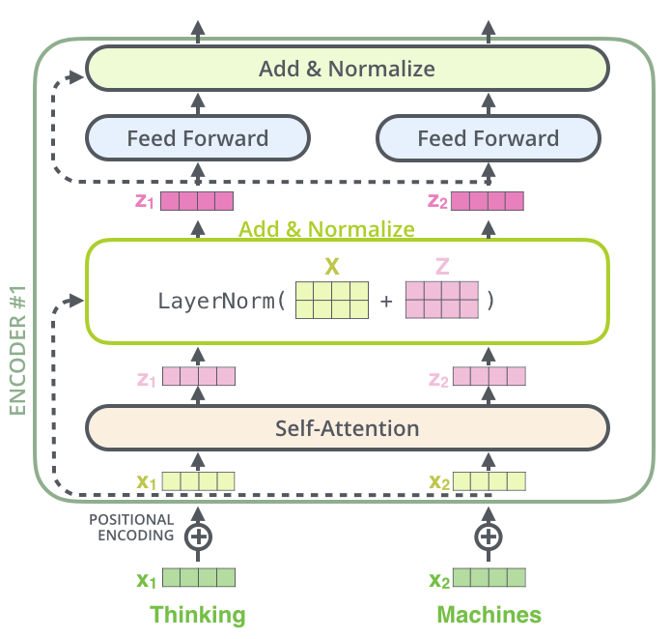
Transformer: Layer-Norm
Blog of Alammar

Slide 27
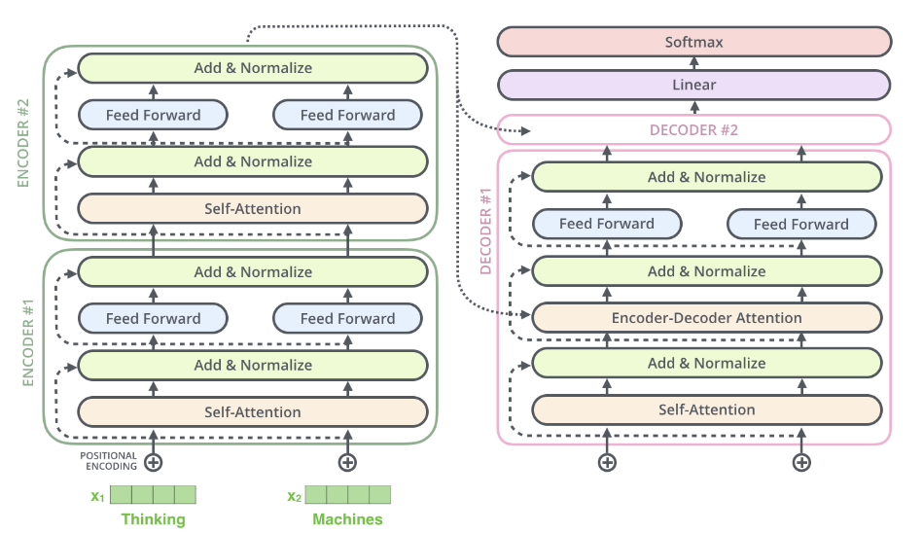
Transformer
Blog of Alammar

Slide 28

Transformer: Decoder
Blog of Alammar

Slide 29

Transformer: Decoder
Blog of Alammar

Slide 30
Transformer: Decoder
Blog of Alammar

Slide 31
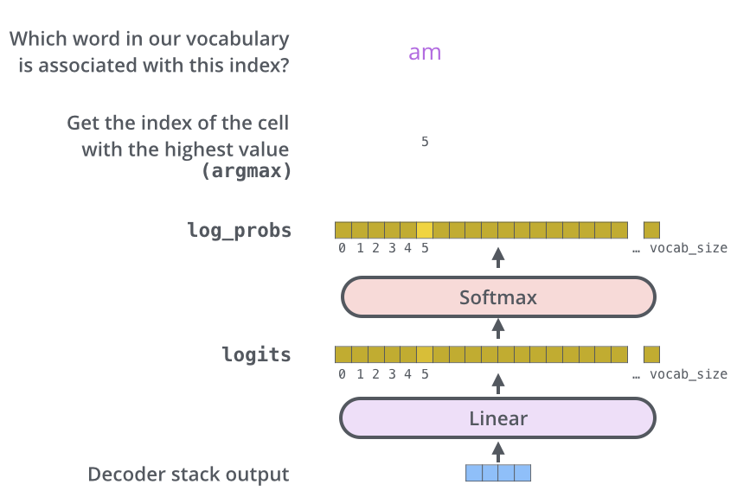
Transformer: Linear & Softmax
Blog of Alammar

Slide 32
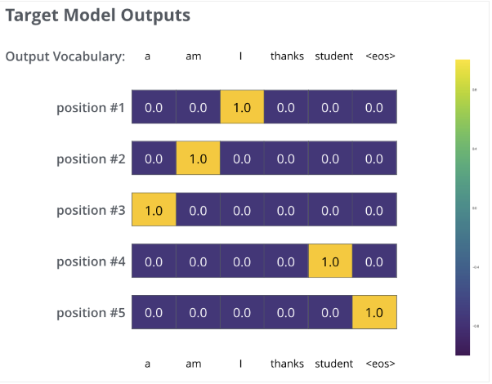
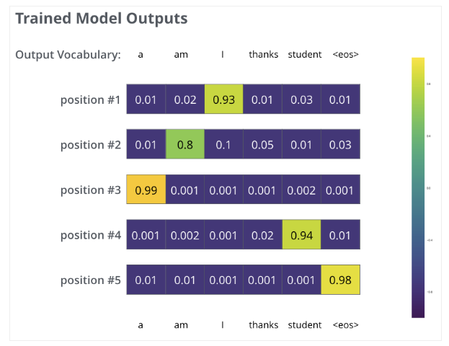
Transformer: Linear & Softmax
Blog of Alammar

Slide 33

Thank you for your attention!

